Slide 1
SENIOR CYCLE OPTIONS
1. Leaving Certificate Established [LCE] – 7 subjects

Slide 2
In this presentation we will cover:
The Framework of Qualifications
Your Subject Options
Our Leaving Certificate System
Subject Choice and Higher Education
Using CareersPortal Reach+ to Research
3rd Level Requirements
Relevance of Languages and Sciences
Submitting your Forms
Other Sources of Support

Slide 3
National Framework of Qualifications Quality and Qualifications Ireland (QQI) Awarding body You are here in 5th, 6th year

Slide 4
OPTION 1– Leaving Certificate Established LCE You will take 7 subjects FOR YOUR LC EXAMS
Examinable Subjects:
3 Core Subjects
Irish
English
Mathematics
4 Choice Subjects
Choose 6 subjects in order of preference on your form
The school will try to give you your top 4
Non-Exam Subjects:
Religious Education
Relationships & Sexuality Education
Career Guidance
Physical Education

Slide 5
your options during school timetabled hours in order of preference1-to 6
Subject Grouping | Subject
Artistic/Creative | Art, Music
Business | Accounting, Business
Humanities | French, German, History
Sciences | Biology, Chemistry, Physics, *Computer Science
Social Sciences | Geography, Home Economics, *Physical Education
Subjects with * symbol are new this September, subject to student interest

Slide 6
* TWO NEW SUBJECTS ON OFFER WITHIN SCHOOL TIMETABLE……. SUBJECT TO STUDENT INTEREST
PHYSICAL EDUCATION
Leaving Certificate Physical Education (LCPE) | NCCA
Physical Education | CareersPortal.ie
COMPUTER SCIENCE
Computer Science | NCCA
Computer Science | CareersPortal.ie

Slide 7
order of preference on subject choice form
When you will enter your subjects, they must be in genuine order of preference, 1 being the subject you most want, 2..3..4.. With 5 and 6 as back up plans if you don’t get your first 4. The school will try to get you your top 4, so make sure you get this right and be happy with your 5th and 6th.
As Applied Maths and Agricultural Science are outside of school hours, they will not be options on your subject choice options form. You will send your interests in these areas directly to Ms Norris.

Slide 8
Possible 8th subject outside school hours?
Applied Mathematics
Agricultural Science facilitated by school. Fee based.
Students were asked to email their name & outside subject of interest (Ag Science or Applied Maths) to Ms Norris before November 30th and you can still do this. Email niamh.norris@stmarysmidleton.com
Please Note: If you intend on taking any other subjects as an 8th subject outside of school and sitting the exam here, you must be aware that taking these subjects independently may not meet Department of Education requirements. Please check with Ms Norris.

Slide 9
Questions to ask yourself
What subjects have you in mind?
What is involved in taking the subjects?
Will the subjects you have selected meet college matriculation (entry) requirements?
You must do the research yourself, YOU will make a better decision.

Slide 10
OUR LEAVING CERT SYSTEM

Slide 11
HOW OUR SYSTEM/SUBJECT CHOICE APPLIES TO COLLEGE
Meeting college requirements
minimum and specific matriculation (entry) requirements
Meeting points requirements
Use CAO website as quick access to college courses to check out entry requirements:
Central Applications Office (cao.ie)

Slide 12
consider our grading and points system
You cannot fail the Leaving Cert – You get your certificate regardless of how you perform.
You will require 6 recognised Leaving Cert subjects for entry to all Higher Education Institutions (HEI’s) Level 8 Abinitio Degrees. This is 3rd level college. You must meet minimum entry requirements, specific requirements if they apply.
LCVP is not recognised as a Leaving Cert subject, but LCVP is recognised for LC points only.
Top 6 subject grades in Leaving Cert are counted for points at Honours and Ordinary Level and Common Level (LCVP)

Slide 13
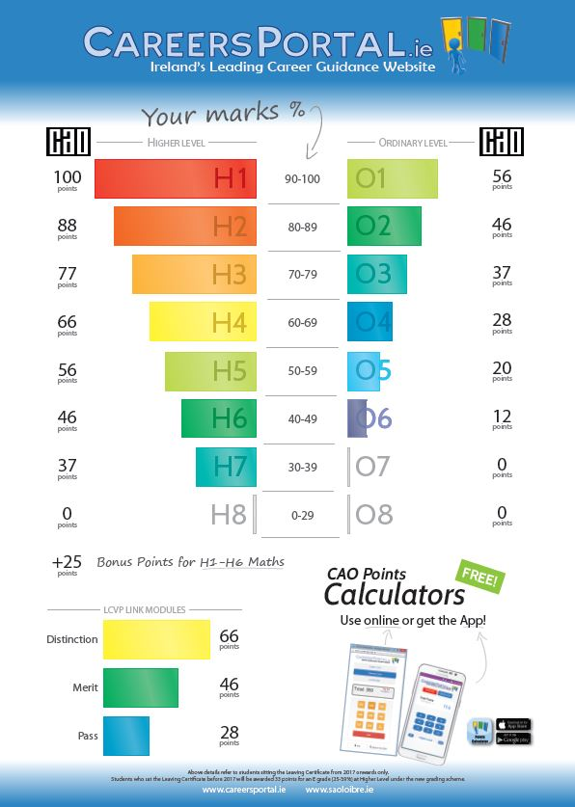
44 points difference H and O
Pass grade

Slide 14
consider our grading and points system
Points for LCVP Common Level (see LCVP section)
Up to 44 points difference between an Honours (H) and Ordinary (O) level paper
Points for a H7, regarded as a pass grade (30-39%)
25 bonus points for Honours Maths (H1-H6 only)
Foundation Level Maths – will meet some course requirements and a small number will allow points.

Slide 15
So now that I understand the system…

Slide 16
in terms of subject content, assessment…… research on careersportal is the key to good subject choice
Detailed research on subjects (course content, assessment, career related areas)
Log in: World of education Leaving Cert subjects app.
Access subject information from your Reach+ or directly from CareersPortal website Leaving Cert Subjects | CareersPortal.ie

Slide 17
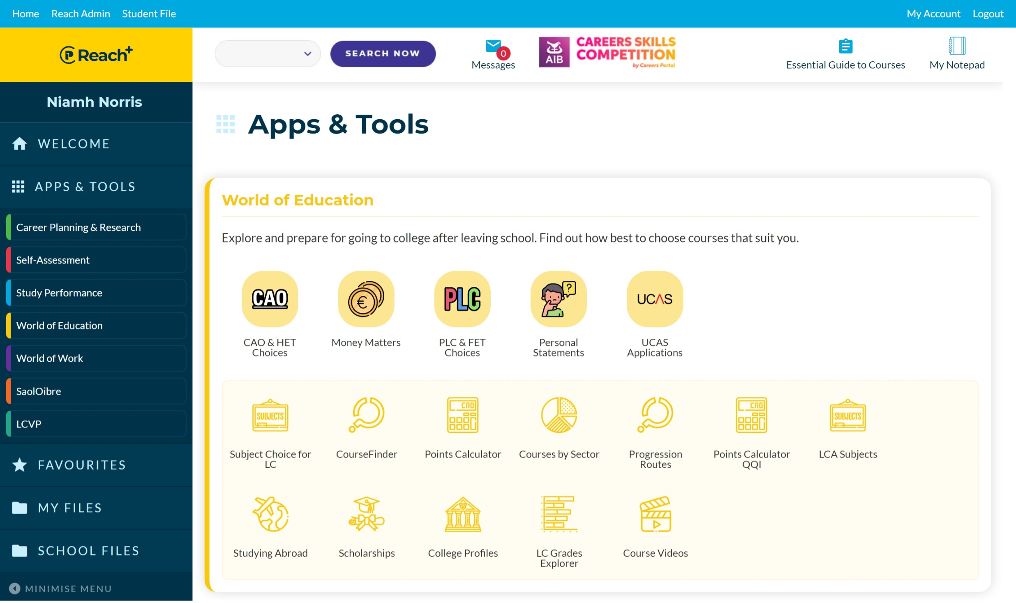
Using your CareersPortal account to research
Leaving Cert Subjects | CareersPortal.ie

Slide 18
Consider the following – 3rd level
What are the subjects you many need e.g., science subject for Nursing is required
What subjects do you enjoy
What subjects do you perform well in
The are the useful subjects for a possible career
The subjects that compliment each other

Slide 19
Meeting college matriculation (entry) requirements

Slide 20
Level 8 Abinitio Hons Degree Minimum Requirements
H5 in 2 subjects O6/H7’s in 4 subjects minimum for most colleges
National Universities (NUI) eg UCC
Irish & English (for all courses) unless exempt
TRINITY, UL, Mary I : English, Maths, another language (3rd language or Irish)
DUBLIN CITY UNIVERSITY: Maths and English or Irish
COLLEGES OF EDUCATION (teaching) e.g. Mary Immaculate College, Limerick
Irish H4, English 04/H7, Maths O4/H7
NOTE: YOU MUST CHECK ABOVE WITH GUIDANCE COUNSELLOR AND/OR COLLEGE/CAO WEBSITES

Slide 21
Institutes of technology/technological university requirements
Level 8 Ab-initio Honours Degree
2 H5’s, 4 O6/H7’s mimimum
Maths, English or Irish
Level 6- Higher Cert. (2yrs) & Level 7- Ordinary Degree (3yrs)
5 O6/H7’s minimum
Maths, English or Irish
Note 1: You can progress from level 6 to Level 8
Note 2: You must check with Guidance Counsellor and/or college/CAO websites to get the most up to date information

Slide 22
specific requirements Some examples
SOME SCIENCE AT UCC – H4 in a Laboratory Science subject or Mathematics or Applied Mathematics or Computer Science
BIOMEDICAL SCIENCE (joint UCC, MTU ) – H4 Lab Science Subject
VET MEDICINE, UCD – H5 Chemistry/ Practical experience
MEDICINE/DENTISTRY/PHARMACY, UCC– H4 in Chemistry and H4 Physics or Biology for 5 year courses, + HPAT for Medicine
MEDICINE for 6 year courses nationally – one lab science subject
SPEECH & LANGUAGE THERAPY UCC – H4 in Lab Science and H4 in language other than English
VERY IMPORTANT TO CHECK WITH GUIDANCE COUNSELLOR OR COLLEGE/CAO WEBSITE

Slide 23
THE SCIENCES: Considerations

Slide 24
science subject or not? some examples
1 Science (at least)
Lab Science Degrees
Radiography
Optometry
Occupational Therapy
Veterinary Medicine/Nursing
Speech & Language Therapy
Public Health Science
Engineering
Food Science
Nursing
Home Economics Teaching Sligo
Medicine – 6 year course
2 Science Subjects at UCC
Medicine (5 year course)
Dentistry (5 Yrs)
Pharmacy (5 Yrs)
Medical & Health Science
Courses vary so check with Guidance Counsellor

Slide 25
Other specific requirements
ART
Portfolio essential
NCAD - pass in Art or 3rd language for entry
MTU – Portfolio but no requirement to have Leaving Cert Art
MUSIC
Grade 6,7 standard usually required, but not always
Entrance Performance test required for music courses.
Not all colleges require music as LC subject e.g. UCC,MTU
COMPUTER SCIENCE
Computer Science is accepted as science subject for some not all science related degrees. Check college / CAO website.
HOME ECONOMICS
H5 in either Home Economics or Lab Science Subject for Home Economics/Business Teaching at MTU

Slide 26
Other Specific requirements in sciences– be careful
GEOGRAPHY:
Accepted as science subject (H4) for Pharmacy, Science at TCD
Generally, not accepted where a lab science subject is required
AGRICULTURAL SCIENCE
Accepted as General Entry Requirement in Science area
Does not meet Specific Requirements for some courses eg. Medicine, Dentistry, Pharmacy, Medical and Health Science - UCC.
Check with Guidance Counsellor and/or college website.

Slide 27
thinking of europe for sciences?
If you are considering medicine/some sciences in EU, where entry requirements are lower (No points requirement), you may need 4 science subjects
e.g. Netherlands where fees are lowest in EU - 3 H5's to include Bio, Chem, Physics, Maths (or Applied Maths)
www.eunicas.ie - For any information on courses delivered through English in EU.

Slide 28
LANGUAGES:
Considerations

Slide 29
3rd Language REQUIRED
Required for most, not all courses in the NUI’s
Arts, Human/Social/Health Sciences, Law, Commerce – some vary
NUI Colleges - UCC, UCD, NUI Galway, NUI Maynooth and associated colleges those being:
Institute of Public Administration
Royal College of Surgeons
Burren College of Art
Institute of Banking
St. Angela’s Sligo
National College of Art and Design
Shannon College of Hotel Management
Cadetship – Army, Navy (You will qualify if exempt)
Courses where languages are a key component of course

Slide 30
no 3rd language:
University of Limerick, Mary I, Trinity College, or DCU, Irish will cover.
Entry to Engineering and Lab Science Degrees, Nursing in NUI Colleges
Gardai (require English and another language, you can use Irish)
Institutes of Technology/Technological University, where language is not a component of the course
Post Leaving Cert Colleges - colleges between secondary school and 3rd Level (1, 2 Year courses)

Slide 31
language exemptions – For Universities
If you are exempt from Irish and/or third language on grounds of disability, you can apply for exemption to meet minimum entry requirements. Consultant report required. Do this in 5th Year, email CAO number in 6th.
If you are exempt from Irish due to nationality status, you can apply for Irish exemption in 5th, email CAO number in 6th.
If you were born outside the Irish state and have completed your full education here, you can apply to use Irish as your third language, and therefore meet minimum entry requirements for third language. (New this year)
Note: You don’t need to apply for Exemptions to Technological Uni’s.

Slide 32
Other helpful Subjects (not specific requirements, even in degrees associated with them)
History – helpful for Law, Arts and course which requires substantial reading
Home Economics - helpful for Food Science, Nutritional Science, Dietetics, Home Ec. Teaching in Sligo
Business - helpful for Commerce, Business/IT, Finance, Business and Law
Accounting - helpful for Accounting, Finance, Business/IT, Commerce. Exception: Accounting required for Accountancy at NUIG

Slide 33
Recap -To Keep college Options Open
Essential subjects – what do you need?
Meet language requirement for many Uni courses
Meet science requirement (if you wish to pursue a Science related degree)
If you struggle with Languages or Science, there are back door routes to 3rd level through PLC courses.

Slide 34
You are not expected to know now, what you want to do after your Leaving Cert, so here are the SAFE BETS
Covers almost every course in Ireland
Irish
English
Maths
3rd language (French or German)
A lab science subject (from Biology, Chemistry, Physics)
NOTE: YOU HAVE A CHOICE WITH 3RD LANGUAGE AND SCIENCE SUBJECTS, IF TOO DIFFICULT TAKE BACK DOOR ROUTES TO THIRD LEVEL

Slide 35
SUBMITTING YOUR SUBJECT CHOICE FORM ONLINE

Slide 36
Supports & submission of your online form
Regarding college implications :Speak with Ms Norris (call to office or email at senioroptions@stmarysmideton.com
Regarding subject content: See CareersPortal and speak to your teachers – you have already experienced most subjects.
Your form will be filled out online by you and your parent(s)/guardian(s) on the school VSware.
Parent(s)/guardian(s) will receive a text and information on the school app/website explaining how to fill out the online form.
Form will be open for submission Friday 28th January
Closing date 4th February 2022
Queries to vsware@stmarysmidleton.com regarding issues with submissions e.g. log-in issues, filling online form

Slide 37
IN GENERAL – BE PRACTICAL
7, 8 subjects max
Do not take on any more than 8 subjects for your Leaving Certificate in the hope of getting more points, it is too much pressure and time consuming. Stats show other subjects suffer.
Points
Try not to become overly-concerned about points. Points are calculated on your 6 best subjects. There are back door routes into courses. You will have 20 course choices on CAO.
Research now
Don’t make the assumption that you can change subject choices in September 22.
YOU ARE NOT GUARANTEED A CHANGE, ESPECIALLY WHEN CLASSES ARE FULL

Slide 38
3rd Years going straight to 5th
You must submit your name to the Guidance Department if you intend on going straight to 5th Year as an account has to be set up for you on VSware.
IN THE MEANTIME, RESEARCH IS KEY!

Slide 39
ADDITIONAL RESEARCH OPTIONS TO CAREERSPORTAL
www.qualifax.ie
www.cao.ie
www.ucc.ie
www.mtu.ie
www.wit.ie
Thank You

